Slide 1
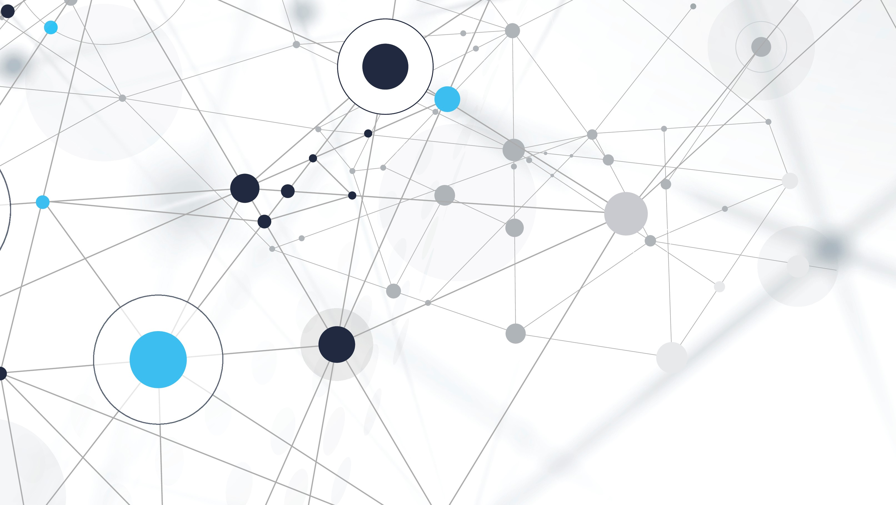
Artificial inteligense in medicine
Examples of artificial intelligence in medicine
The presentation was prepared by Adam Denis IS11Z

Slide 2
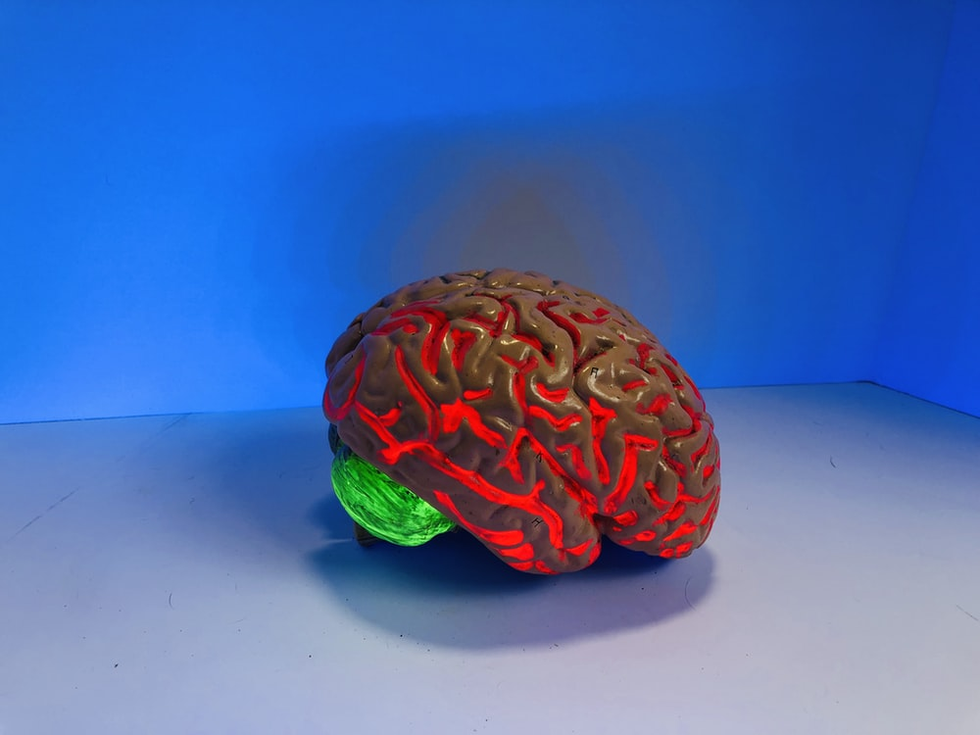
Definition of AI
Artificial intelligence ( AI ) - the property of intelligent systems to perform creative functions, which are traditionally considered the prerogative of a person (should not be confused with artificial consciousness , IP); science and technology of creating intelligent machines , especially intelligent computer programs .
AI is related to the similar task of using computers to understand human intelligence , but is not necessarily limited to biologically plausible methods.
Intelligent systems existing today have rather narrow areas of application. For example, programs that can beat a person at chess cannot answer questions, etc.

Slide 3
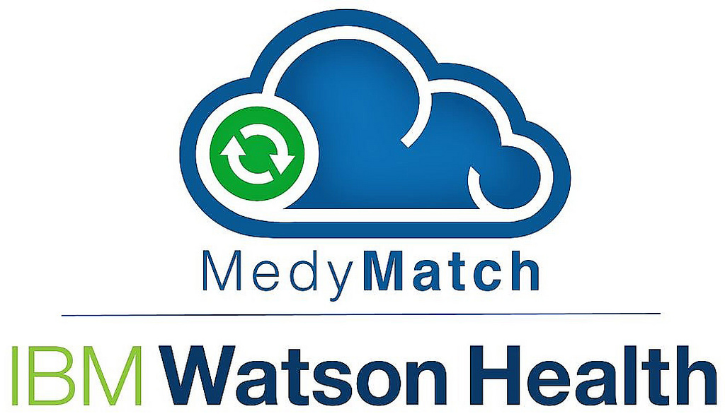
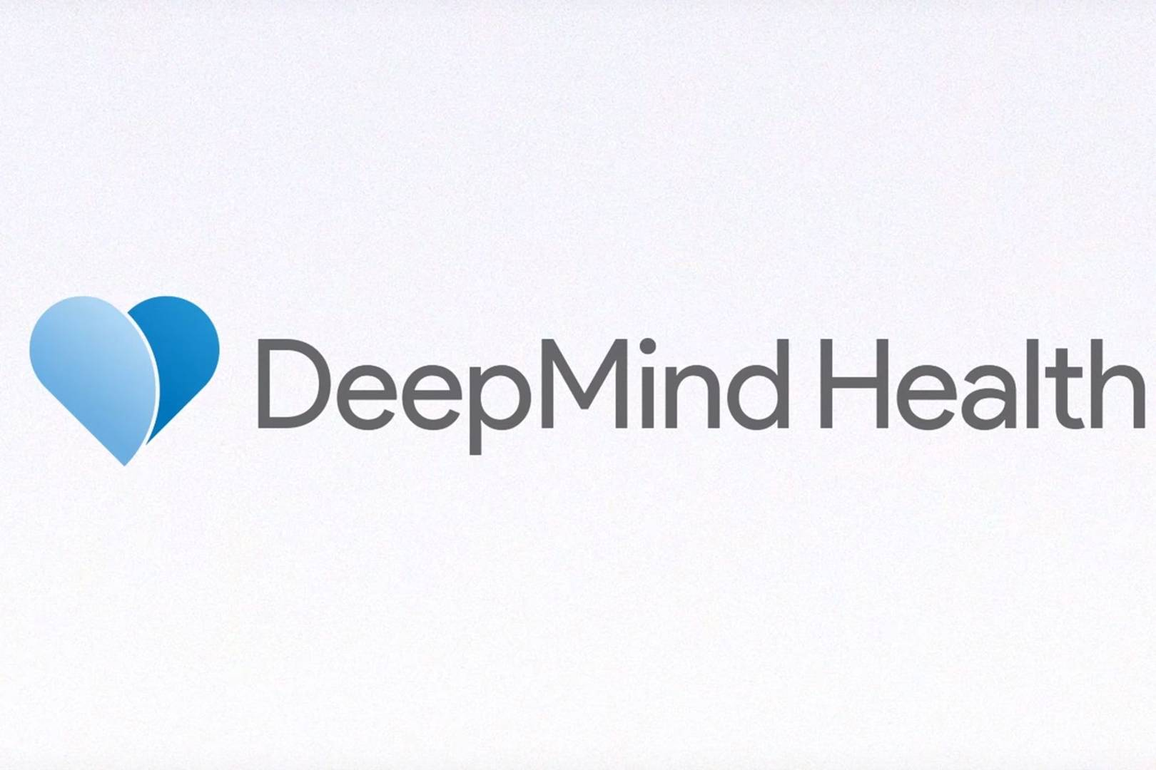
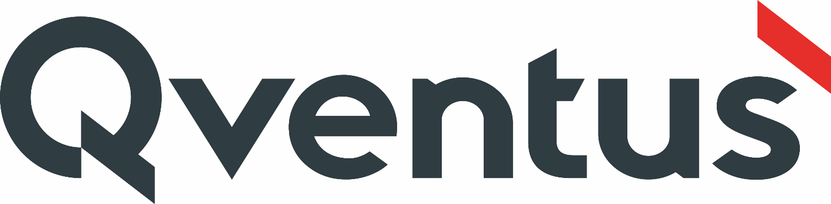

Examples of artificial intelligence in medicine

Slide 4
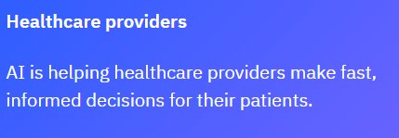

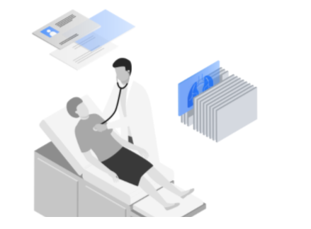
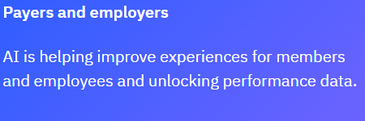
Ibm Watson Health
How AI is impacting healthcare
Health professionals make decisions that affect the health and well-being of their patients, members and citizens every day. They need technology that can help inform their decisions, automate their daily tasks and empower them to do their best work for the people they serve.
See how artificial intelligence (AI) solutions from IBM Watson Health are doing just that for organizations across the healthcare industry.

Slide 5

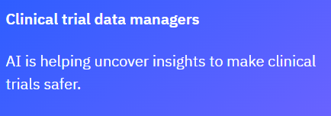

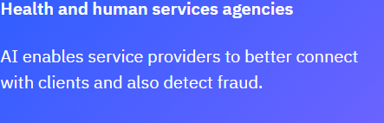
https://www.ibm.com/watson-health

Slide 6
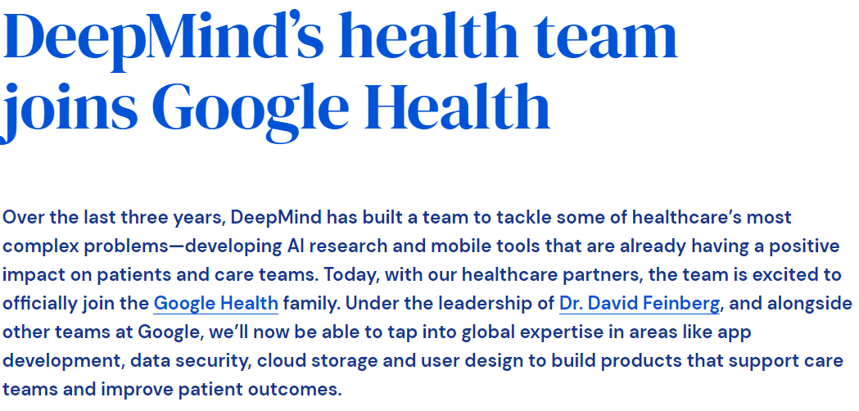
deepmind.com

Slide 7
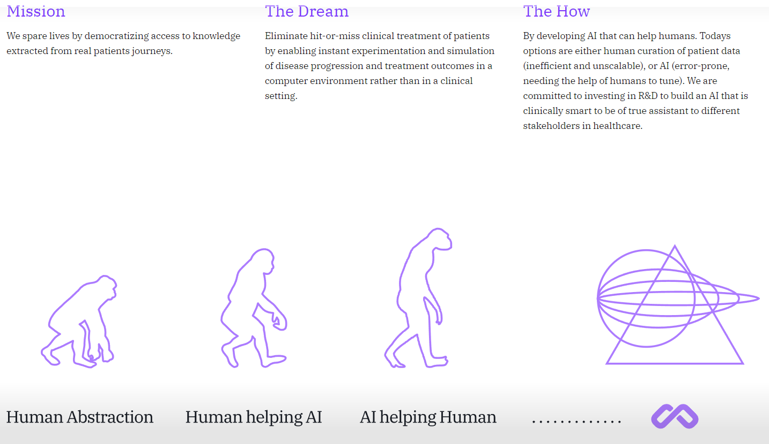
www.mendel.ai

Slide 8
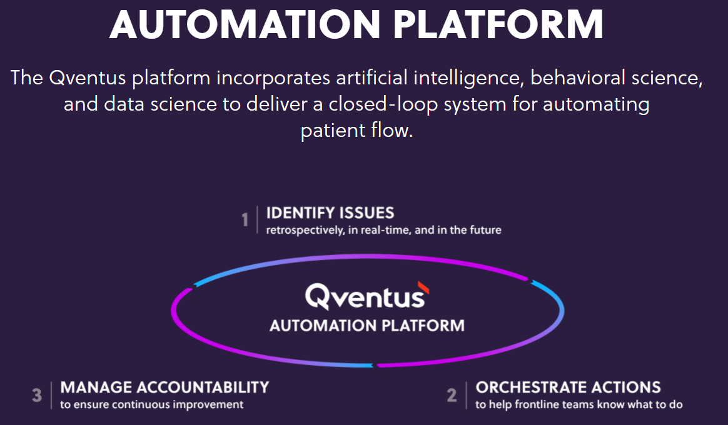

Slide 9
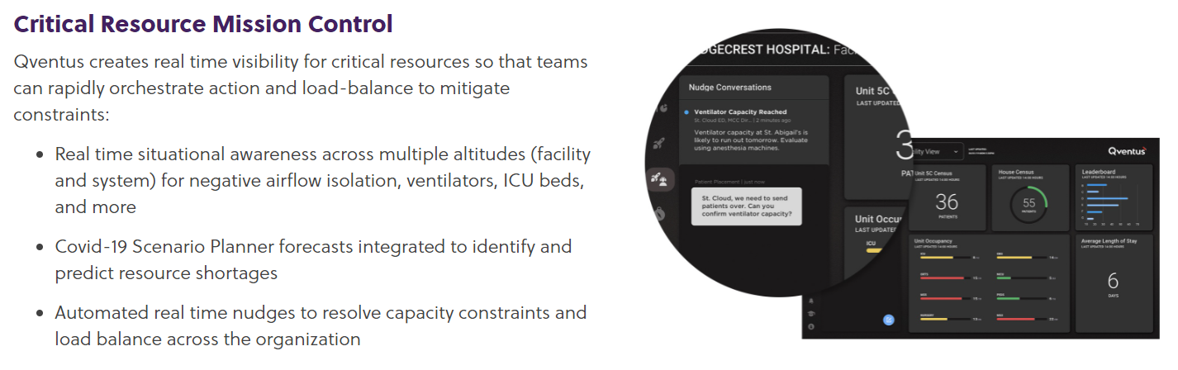
https://qventus.com

Slide 10
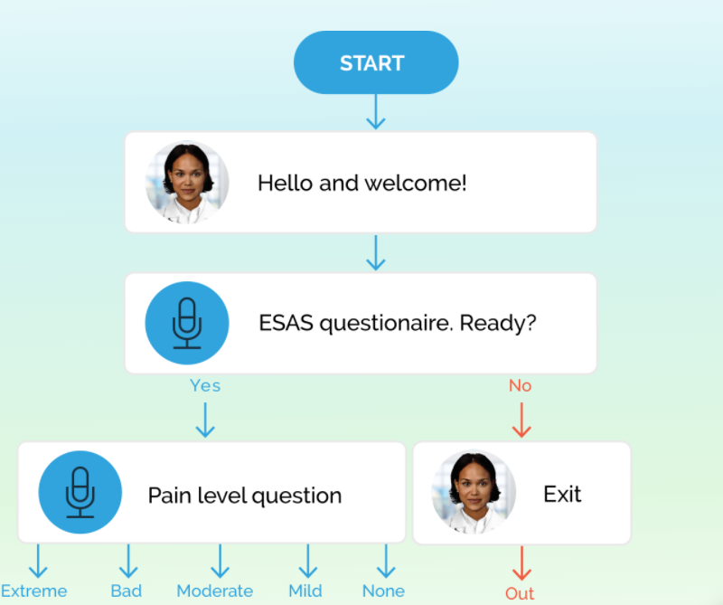
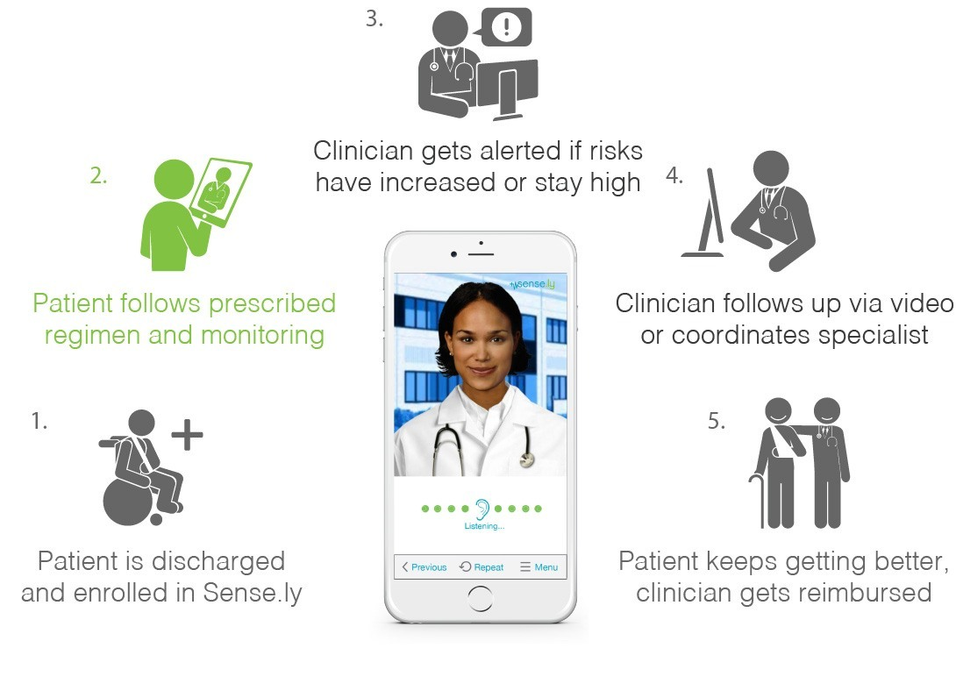
Sense.ly
Nurse app
https://www.sensely.com

Slide 11
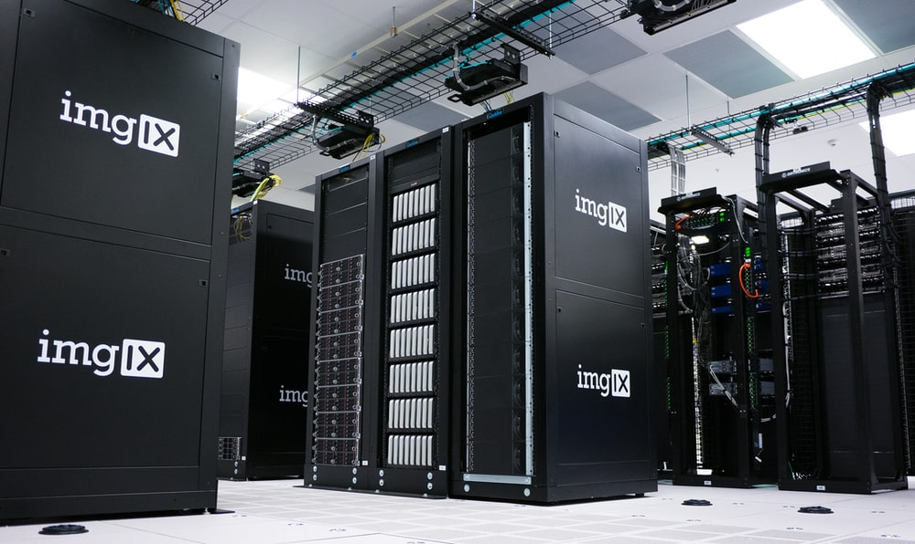
problems of integrating artificial intelligence into our lives
Problem 1: to train a neural network you need huge amounts of data. In order to get results with an acceptable degree of accuracy at the output of the neural network, a significant amount of data must be fed to the input.According to statistics from the American Cancer Society, the most common form of cancer in the U.S. in 2016 was breast cancer (more than 240,000 cases detected). That's not enough data to train a neural network. If we take rarer forms of cancer, the number of detected cases there is ten times less (for example, 53,000 cases of pancreatic cancer, 62,000 cases of leukemia, 64,000 cases of thyroid cancer, etc.). Obviously, such statistics are not enough; the millions of cases needed for training would take decades to collect. And this despite the fact that mortality in some rare forms of cancer can be as high as 80%. It is encouraging that mixed methods of machine learning (so-called semi-supervised learning), which require hundreds of times less data at the input of the neural network, are actively developing.

Slide 12

Problem 2: the issue of confidentiality of personal health information. Access to personal health information is a rather sensitive issue and is often regulated by various laws and regulations. In the United States, the HIPAA (Health Insurance Portability and Accountability Act) passed in 1996 is one. Many questions arise about where and how this data will be stored and who will have access to it. Who will finance the development, implementation and maintenance of such systems? The recent scandals with various hacking, leaks and attacks, unfortunately, do not add to the optimism.

Slide 13

Problem 3: human fear. Obviously, it is easier (for now) for a patient to trust a human to perform a diagnosis/surgery than a computer (not to mention autonomous robots), albeit with highly developed AI. Not all psychological barriers are easily (and quickly) overcome.

Slide 14


